Slide 1

İnventory management system-Store product details in a binary search tree (BST) for fast lookup
Teacher: Quluzade Dilare
Student: Tanat Imanli
Faculty: ITT
Field of study: Information technology
Subject: Data Structures and Algorithms
Course: I
Term: Spring term

Slide 2
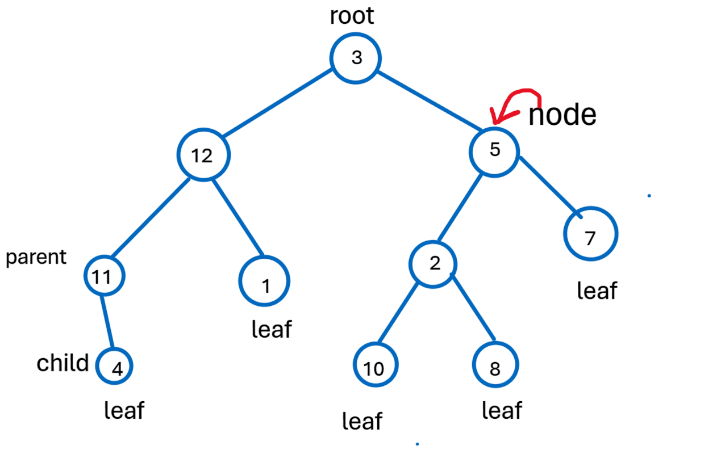
What is binary tree?
Binary tree A hierarchical data structure in which each node has at most two children, referred to as left and right.
In a binary tree, each node can have 0, 1, or 2 children.
A node with 0 children is called a leaf.
The topmost node in a binary tree is called the root.

Slide 3
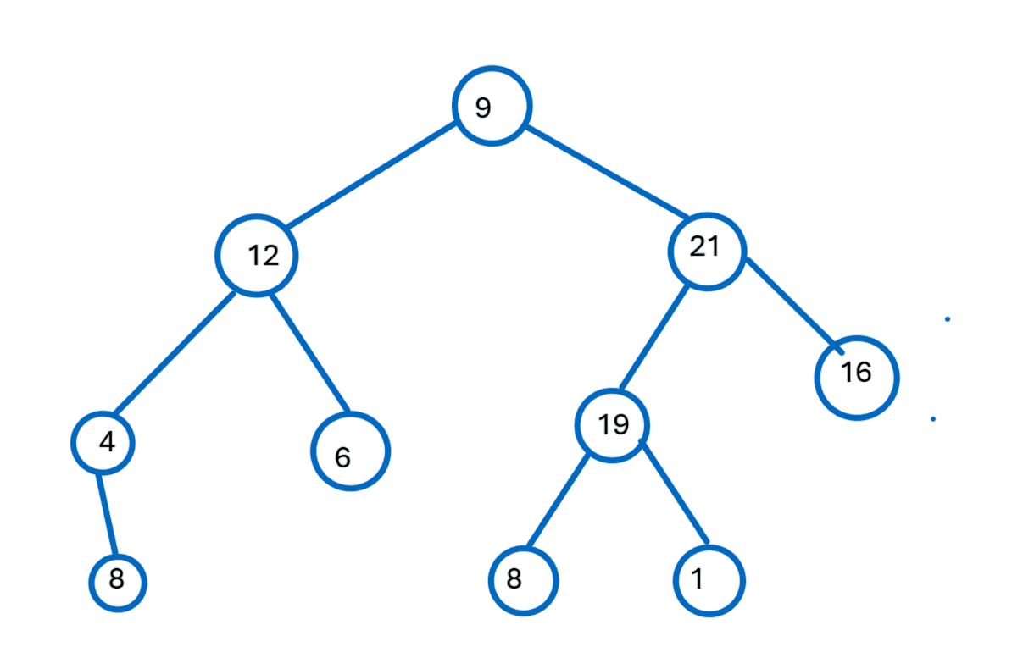
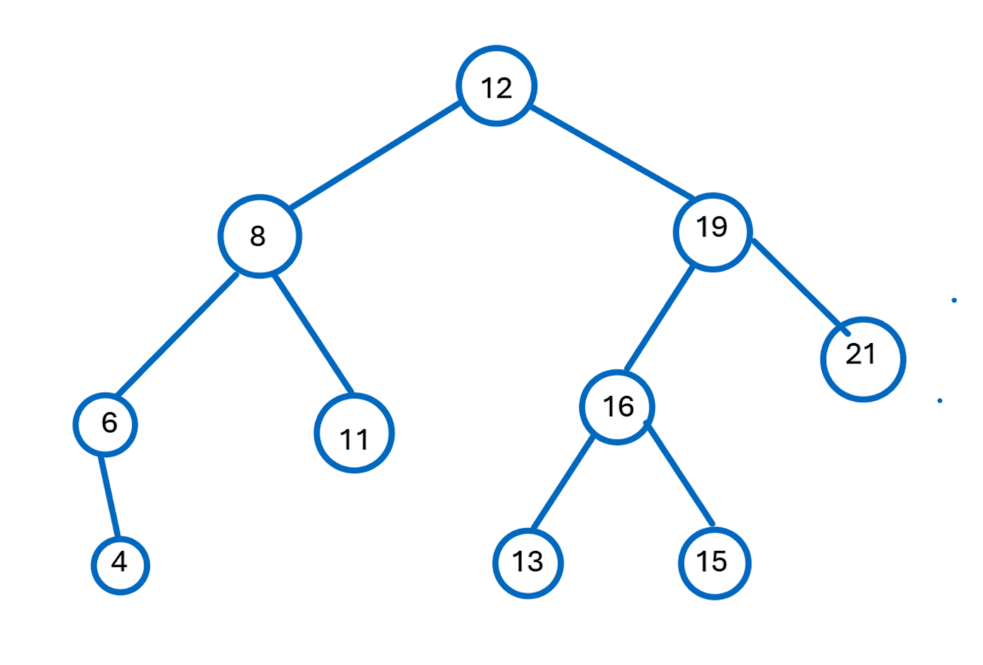
What is binary search tree?
A Binary Search Tree is a Binary Tree where every node's left child has a lower value, and every node's right child has a higher value.
It is binary search tree
It is not binary search tree

Slide 4
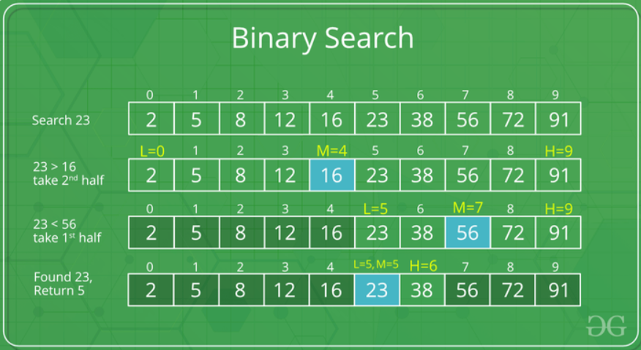

Binary search is more quick than Linear Traversal
time complexity is log (n)
time complexity is n

Slide 5
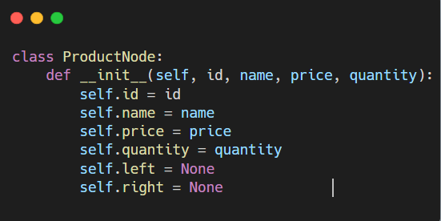
Product Node: Node Structure
In our Inventory Management System, each product is represented as a node in the Binary Search Tree (BST). The Product Node class holds all the essential product information and two pointers: left and right, which are used to build the BST structure.
Key Attributes :
id: A unique identifier for each product.
name: The name of the product.
price: The unit price of the product.
quantity: Number of units available in stock.
left: Reference to the left child (smaller ID).
right: Reference to the right child (greater ID).

Slide 6
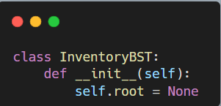
InventoryBST: BST Structure and Initialization
The InventoryBST class represents the Binary Search Tree (BST) used to manage all products in the inventory. It contains the root node, which serves as the entry point to the entire BST.
At initialization, the tree is empty — no products are inserted yet.
Key Attributes :
self.root: This variable stores the top node of the tree.
Note:
After creating inv = InventoryBST(), the BST is empty.
Once you start adding products with insert(), root will be set to the first product’s node.

Slide 7
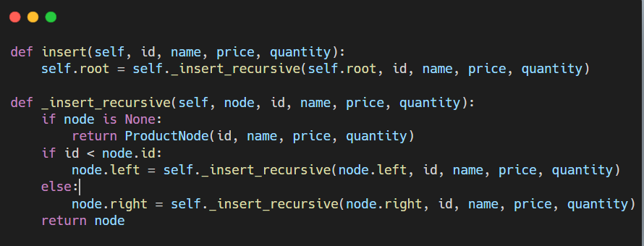
Inserting a Product into the BST
The insert() method adds a new product to the inventory. Products are placed in the Binary Search Tree according to their unique id values. If a product with the same ID already exists, insertion is denied to ensure data integrity.
The insertion process is done recursively.
Key Logic :
If id<current.id → go left.
If id >current.id → go right.

Slide 8
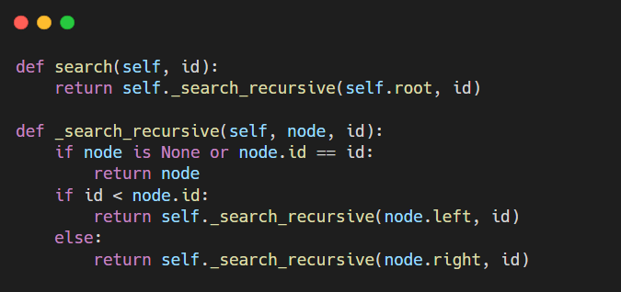
Searching a Product by ID
The search() method allows us to locate a product by its unique ID within the Binary Search Tree. It uses recursion to traverse the tree efficiently, based on the properties of a BST.
How it work:
Start from the root.
If the current node is None → product not found.
If id == current.id → product found!
If id < current.id → go left.
If id > current.id → go right.

Slide 9
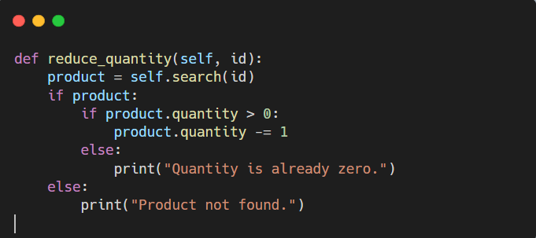
Reducing Product Quantity by 1
This method is used to reduce the quantity of a product by one unit. It first locates the product by its ID using the search() method. If the product is found and quantity > 0, it decrements the quantity.
Update Rules::
If product not found → show error message.
If quantity already 0 → no reduction.
Otherwise → subtract 1 from quantity.

Slide 10
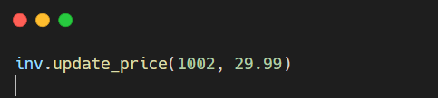

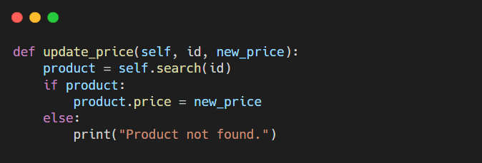

Updating the Price of a Product
This method allows the user to change the price of a product that already exists in the inventory. To do so, the system first searches the product by its unique ID, and then updates the price field of the corresponding node.
If the product with the given ID is not found, an error message is displayed.
Why is this needed?:
Product prices may change over time due to market conditions.
Instead of deleting and re-adding the product, we simply update its price.
Before:
After:

Slide 11
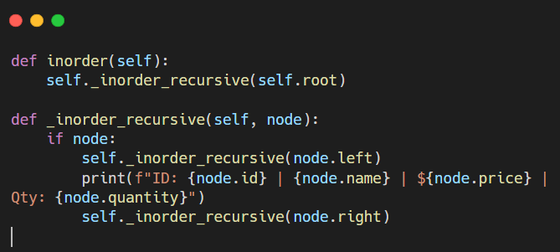
Displaying All Products in Order (Inorder Traversal)
The inorder() method is used to display all products in ascending order of their IDs. This is possible because in a Binary Search Tree (BST), an inorder traversal naturally visits nodes in sorted order.
Traversal Rule:
Left → Current Node → Right
This ensures the smallest ID comes first, and the largest comes last.

Slide 12
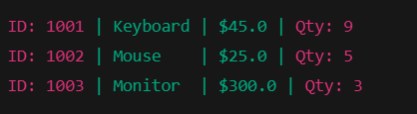
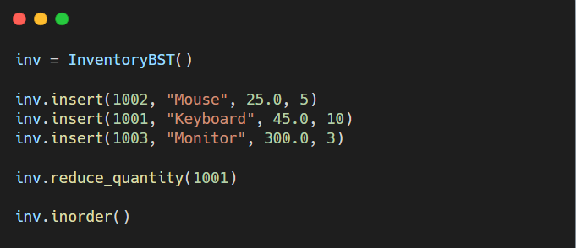
Sample Usage and Execution Flow
This example demonstrates how the InventoryBST system works step by step:
Add multiple products using insert()
Decrease the quantity of one product using reduce_quantity()
List all products in order using inorder()
Expected Output:

Slide 13


